Slide 1
Interrupts and Exceptions: Introduction
I. Ghansah
Revision date: 4/18/2021

Slide 2
Interrupt Handling
Overview
Hardware Interrupts
Interrupt Control Instructions
Writing a Custom Interrupt Handler
Terminate and Stay Resident Programs
The No_Reset Program

Slide 3
What is Interrupt?
It is an event that needs the CPU’s attention
CPU should stop whatever it is doing to service this interrupt before continuing from where it left off.
In practice a main program could be running and keyboard interrupt occurs (key has been pressed). We have to leave the main program and execute interrupt service routine (ISR) to collect the key that has been pressed, process it, and return control back to the main program.
In this sense ISR is similar to Procedure Call. But there are some differences.

Slide 4
CPU Instruction Cycle with Interrupts
User
Program
Fetch instruction at IP
mov
add
mov
mul
mov
sub
bne
add
jmp
…
Decode the fetched instruction
Save context
IP
Get INTR ID
Execute the decoded instruction
Lookup ISR
Advance IP to next instruction
Execute ISR
IRQ?
yes
IRET
no

Slide 5
INTERRUPT TYPES
Recall software Interrupts (eg. INT 21h, INT 10h calls). This instruction causes CPU to branch to Interrupt handler (same as ISR).
External Hardware Interrupts where an external device, not programmer, causes us to branch to interrupt handler.
Keyboard interrupt which causes the PC to read a character pressed on the Keyboard.
Ntwk Interface Card (NIC) for Wifi, Ethernet, etc.
External Drives
Printer
…

Slide 6
Some Types of Interrupts and Priorities (x86)
Reset (Highest Priority)
Internal Interrupts and Exceptions (divide by 0,
Software Interrupts: (INT #)
Non-Maskable Interrupts (NMI): External Hardware (memory read errors)
External (maskable) Hardware, INTR (Lowest Priority). These are, KBD, NICs, HDD, etc

Slide 7
Interrupt Vectors
All interrupts involve obtaining a vector (8 bit #) which is used by the CPU to fetch the address of the Interrupt Service Routine (ISR).
The address of the ISRs are in a table in memory beginning at 00h
Each entry (4B) in the table contains IP & CS of the corresponding ISR start address.

Slide 8
Interrupt Vector Table
Mem addr
Vector
Sys Services
..
CS70h
70h*4
IP70h
Vec 70h - CMOS Real Time Clock
..
CS9
Vec 9 - PC Keyboard
9*4
IP9
CS8
Vec 8 - PC Sys Timer OR interrupt table limit too small
8*4
IP8
..
CS2
08
IP2
Vec 2 - NMI
CS1
Vec 1 - debug
04
IP1
02
CS0
Vec 0 - divide error
00
IP0
Note: There is maximum of 256 vectors in Real Mode.

Slide 9
Hardware Requirements for Interrupts
RAM
ROM
INT
INTR
Interrupt Controller
io1
io7
MPU
INTA#
IR₀
IR₇
. . .
reset
NMI

Slide 10
Interrupt Controller in x86 System
Legacy PC Design
(for single-proc
systems)
IRQs
Slave
PIC
(8259)
Master
PIC
(8259)
x86
CPU
Ethernet
INTR
SCSI Disk
Real-Time Clock
Keyboard Controller
Programmable Interval-Timer

Slide 11
Overview
Interrupt handler (interrrupt service routine) – performs common I/O tasks
can be called as functions
can be activated by hardware events
Examples:
video output handler
critical error handler
keyboard handler
divide by zero handler
Ctrl-Break handler
serial port I/O

Slide 12
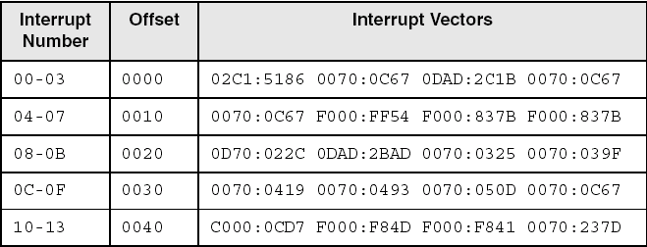
Interrupt Vector Table
Each entry contains a 32-bit segment/offset address that points to an interrupt service routine
Offset = interruptNumber * 4
The following are only examples:

Slide 13
Hardware Interrupts
Generated by the Intel 8259 Programmable Interrupt Contoller (PIC)
in response to a hardware signal
Interrupt Request Levels (IRQ)
priority-based interrupt scheduler
brokers simultaneous interrupt requests
prevents low-priority interrupt from interrupting a high-priority interrupt

Slide 14
Common IRQ Assignments
0 System timer
1 Keyboard
2 Programmable Interrupt Controller
3 COM2 (serial)
4 COM1 (serial)
5 LPT2 (printer)
6 Floppy disk controller
7 LPT1 (printer)

Slide 15
Common IRQ Assignments
8 CMOS real-time clock
9 modem, video, network, sound, and USB controllers
10 (available)
11 (available)
12 mouse
13 Math coprocessor
14 Hard disk controller
15 (available)

Slide 16
Int 21H
Interrupt handler
Interrupt vector table
..
..
iret
Your program
mov ...
Int 21H
Add ...
DOS
21H
..
..
iret

Slide 17
Interrupt
Interrupt handler
Interrupt vector table
..
..
iret
Your program
mov ...
Add ...
Interrupt handler
..
..
iret

Slide 18
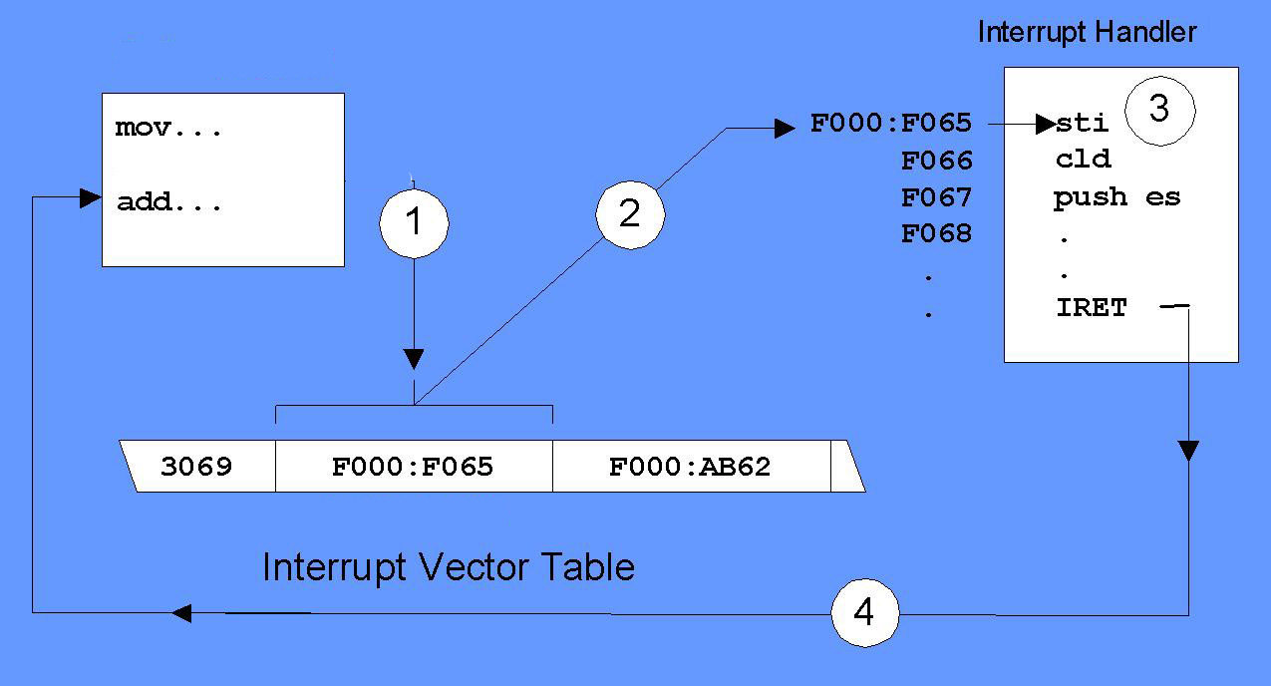
Hardware interrupt
Keyboard
interrupt
Your program

Slide 19
Interrupts vs Procedure Calls
Similarities: In each case control is transferred to another routine
Differences
CPU pushes flags, Return Address in that order whereas procedures pushes Ret Addr
Interrupts use vector initially to know where to go
Interrupt routines end with IRET( pops Ret Addr and flags from stack). RET used by procedures pops Ret Addr from the Stack

Slide 20
Interrupt Control Instructions
STI – set interrupt flag
enables external interrupts
always executed at beginning of an interrupt handler
CLI – clear interrupt flag
disables external interrupts
used before critical code sections that cannot be interrupted
suspends the system timer

Slide 21
Writing a Custom Interrupt Handler
Motivations
Change the behavior of an existing handler
Fix a bug in an existing handler
Improve system security by disabling certain keyboard commands
What's Involved
Write a new handler
Load it into memory
Replace entry in interrupt vector table
Chain to existing interrupt hander (usually)

Slide 22
Setting up the Interrupt Vector Table
Place the address (es) of the ISR(s) at the places where the MPU can fetch them using the interrupt vector. NOTE: It’s a good idea to save an old Interrupt Vector before putting your own there. After you get out of the ISR, replace it.
The following code will save an old vector in kbd INT 9 (kbd hw intr)

Slide 23
Saving Old ISR Info
Data segment use16
Oldoff dw ?
Oldseg dw ?
Data ends
Cli ; disable interrupts
Mov ax, 0000h ; ES=0
Mov es, ax
Mov bx, word ptr ES:24h ; save IP of INT 9 (kbd intr)
Mov oldoff, bx ;
Mov bx, word ptr ES:26h ; save CS of INT 9 (kbd intr)
Mov oldseg, bx

Slide 24
Putting Own ISR Addr in IVT
Mov word ptr ES:24h, offset myISR
Mov word ptr ES:26h, seg myISR
sti
Where myISR is the address of my ISR

Slide 25
Example Keyboard ISR
myISR:
Disable interrupts (CLI)
Save status with PUSHA (PUSH All gen. purpose regs)
Perform Service (eg. In case of KBD use IN AL, 60h)
Dismiss Interrupt (End of Interrupt (EOI) )
Enable Interrupts (STI)
Restore status with POPA
Return from Interrupt (IRET)
Dismissing interrupts can be done as follows.
Mov al, 20h ; Issue End Of Interrupt (EOI)
Out 20h, al ; To Master PIC port 20h

Slide 26
Main Program
Must run in a Loop (preferably indefinite) in order to catch the Hardware Interrupt.

Slide 27
Protected Mode Interrupts
Number of Interrupt Vector is unchanged from Real Mode. i.e still 256. The vector assignment is also the same.
Interrupt Vector Table (IVT) is called Interrupt Descriptor Table (IDT)
Entries in the IDT are 8 Bytes vs 4 Bytes in Real Mode. The entries are called Interrupt Gate Descriptors
The IDT can be anywhere in memory. It’s base address is in a CPU register called IDTR (IDT Register )
The actual address to the IVT is no longer 4*vector. Vector it multiplied by 8. But result goes to a GATE.

Slide 28
Interrupt Descriptor Table
The ‘entry-point’ to the interrupt-handler is located via the Interrupt Descriptor Table (IDT)
IDT: “gate descriptors”
Segment selector + offset for handler
Descriptor Privilege Level (DPL)
Gates (slightly different ways of entering kernel)
Task gate: includes TSS to transfer to (not used by Linux)
Interrupt gate: disables further interrupts
Trap gate: further interrupts still allowed

Slide 29
Interrupt Masking
Two different types: global and per-IRQ
Global — delays all interrupts
Selective — individual IRQs can be masked selectively
Selective masking is usually what’s needed — interference most common from two interrupts of the same type

Slide 30
Protected Mode Interrupts
Memory Bus
IRQs
0
PIC
idtr
CPU
INTR
IDT
0
vector
N
handler
Mask points
255

Slide 31
PROTECTED MODE INTERRUPT DETAILS
Interrupt Vector*8
IDT
Destination Code Seg
Offset
Interrupt Handler
Interrupt Gate
+
ISR
+
IDTR
Seg Selector
GDT
Segment Descriptor

Slide 32
SKIP THE FOLLOWING: OPTIONAL

Slide 33
Get Interrupt Vector
INT 21h Function 35h – Get interrupt vector
returns segment-offset addr of handler in ES:BX
.data
int9Save LABEL WORD
DWORD ? ; store old INT 9 address here
.code
mov ah,35h ; get interrupt vector
mov al,9 ; for INT 9
int 21h ; call MS-DOS
mov int9Save,BX ; store the offset
mov [int9Save+2],ES ; store the segment

Slide 34
Set Interrupt Vector
INT 21h Function 25h – Set interrupt vector
installs new interrupt handler, pointed to by DS:DX
mov ax,SEG kybd_rtn ; keyboard handler
mov ds,ax ; segment
mov dx,OFFSET kybd_rtn ; offset
mov ah,25h ; set Interrupt vector
mov al,9h ; for INT 9h
int 21h
.
.
kybd_rtn PROC ; (new handler begins here)
See the CtrlBrk.asm program.

Slide 35
Keyboard Processing Steps
Key pressed, byte sent by hardward to keyboard port
8259 controller interrupts the CPU, passing it the interrupt number
CPU looks up interrupt vector table entry 9h, branches to the address found there

Slide 36
Keyboard Processing Steps
Our handler executes, intercepting the byte sent by the keyboard
Our handler jumps to the regular INT 9 handler
The INT 9h handler finishes and returns
System continues normal processing

Slide 37
Terminate and Stay Resident Programs
(TSR): Installed in memory, stays there until removed
by a removal program, or by rebooting
Keyboard example
replace the INT 9 vector so it points to our own handler
check, or filter certain keystroke combinations, using our handler
forward-chain to the existing INT 9 handler to do normal keyboard processing

Slide 38
The No_Reset Program (1 of 5)
Inspects each incoming key
If the Del key is received,
checks for the Ctrl and Alt keys
permits a system reset only if the Right shift key is also held down
The keyboard status byte indicates the current state of special keys:

Slide 39
The No_Reset Program (2 of 5)
View the source code
Resident program begins with:
int9_handler PROC FAR
sti ; enable hardware interrupts
pushf ; save regs & flags
push es
push ax
push di

Slide 40
The No_Reset Program (3 of 5)
Locate the keyboard flag byte and copy into AH:
L1: mov ax,40h ; DOS data segment is at 40h
mov es,ax
mov di,17h ; location of keyboard flag
mov ah,es:[di] ; copy keyboard flag into AH
Check to see if the Ctrl and Alt keys are held down:
L2: test ah,ctrl_key ; Ctrl key held down?
jz L5 ; no: exit
test ah,alt_key ; ALT key held down?
jz L5 ; no: exit

Slide 41
The No_Reset Program (4 of 5)
Test for the Del and Right shift keys:
L3: in al,kybd_port ; read keyboard port
cmp al,del_key ; Del key pressed?
jne L5 ; no: exit
test ah,rt_shift ; right shift key pressed?
jnz L5 ; yes: allow system reset
Turn off the Ctrl key and write the keyboard flag byte back to memory:
L4: and ah,NOT ctrl_key ; turn off bit for CTRL
mov es:[di],ah ; store keyboard_flag

Slide 42
The No_Reset Program (5 of 5)
Pop the flags and registers off the stack and execute a far jump to the existing BIOS INT 9h routine:
L5: pop di ; restore regs & flags
pop ax
pop es
popf
jmp cs:[old_interrupt9] ; jump to INT 9 routine

Slide 43
What's Next
Defining Segments
Runtime Program Structure
Interrupt Handling
Hardware Control Using I/O Ports

Slide 44
Hardware Control Using I/O Ports
Two types of hardware I/O
memory mapped
program and hardware device share the same memory address, as if it were a variable
port based
data written to port using the OUT instruction
data read from port using the IN instruction

Slide 45
Input-Ouput Ports
ports numbered from 0 to FFFFh
keyboard controller chip sends 8-bit scan code to port 60h
triggers a hardware interrupt 9
IN and OUT instructions:
IN accumulator, port
OUT port, accumulator
accumulator is AL, AX, or EAX
port is a constant between 0 and FFh, or a value in DX betweeen 0 and FFFFh

Slide 46
PC Sound Program
Generates sound through speaker
speaker control port: 61h
Intel 8255 Programmable Peripheral Interface chip turns the speaker on and off
Intel 8253 Timer chip controls the frequency
Source code

Slide 47
Summary
Interrupt Intro: Priorities, Hardware Requirements
Interrupt handlers, interrupt vector table
Hardware interrupt, 8259 Programmable Interrupt Controller, interrupt flag
Protected Mode Interrupts.
Terminate and Stay Resident (TSR) – MAY SKIP
Memory-mapped and port-based I/O - SKIP

Slide 48
The End

